Slide 1
Log-linear Model
Statistical Data Analysis，2023

Slide 2
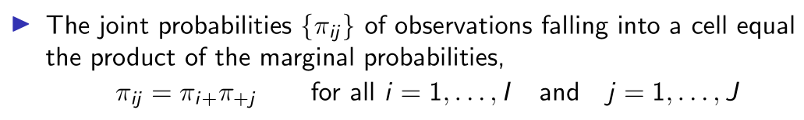
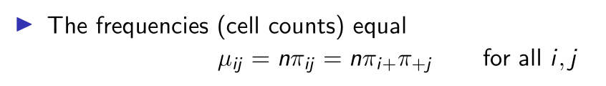
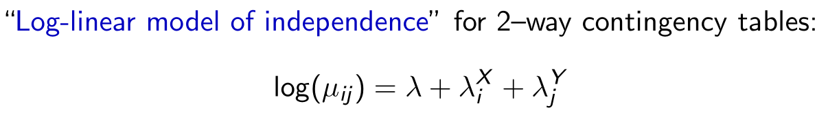
Log-linear model — A Primer
A revisit to the 2-way table:
This can be reformulated as:
← The factor X, Y as predictors, the log cell frequency as response.

Slide 3
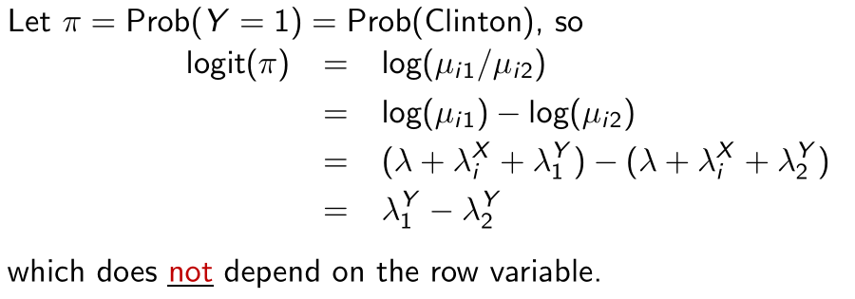

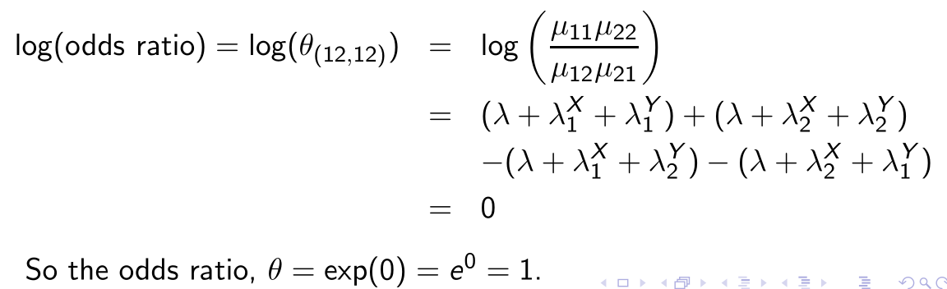
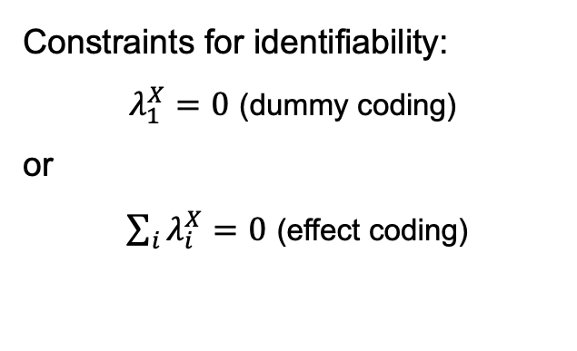
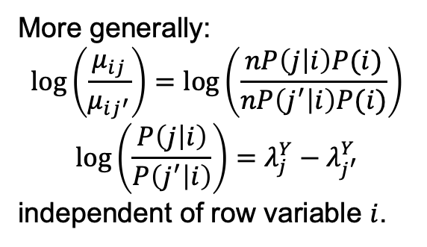
Log-linear model — “ANOVA” representation
Constraints for identifiability:
$λ_{1}^{X}=0$ (dummy coding)
or
$\sum_{i}{λ_{i}^{X}=0}$ (effect coding)
More generally:
$$\log\left(\frac{μ_{ij}}{μ_{ij^{′}}}\right)=\log\left(\frac{nP\left(j | i\right)P(i)}{nP\left(j^{′} | i\right)P(i)}\right)$$
$$\log\left(\frac{P\left(j | i\right)}{P\left(j^{′} | i\right)}\right)=λ_{j}^{Y}−λ_{j^{′}}^{Y}$$
independent of row variable $i$.
Notes:
No. of free parameters: E_ij = n * pi_i * pi_j -> 1+(I-1)+(J-1)

Slide 4


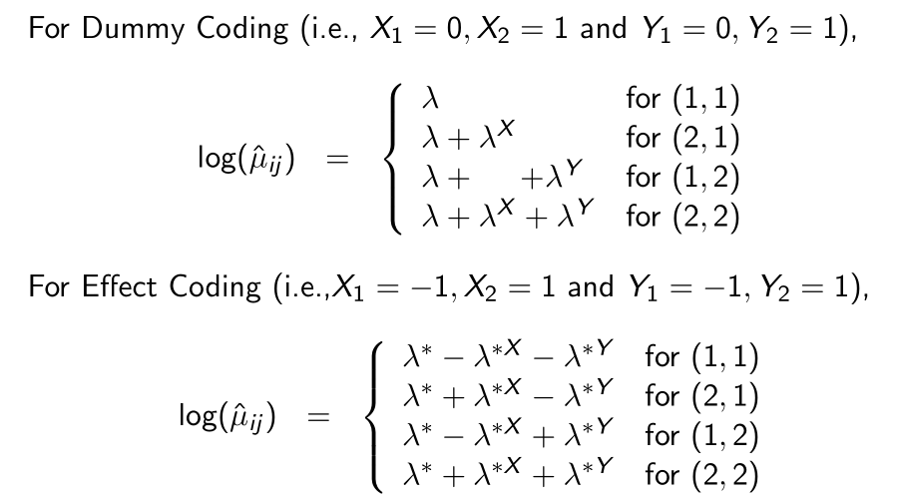
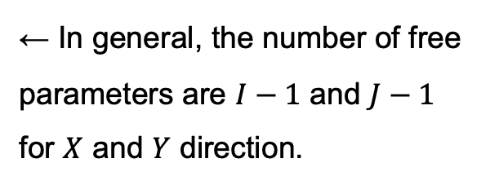
Log-linear model — “Regression” representation
An alternative "linear regression" representation:
← In general, the number of free parameters are $I−1$ and $J−1$ for $X$ and $Y$ direction.
Notes:
No. of free parameters: E_ij = n * pi_i * pi_j -> 1+(I-1)+(J-1)

Slide 5
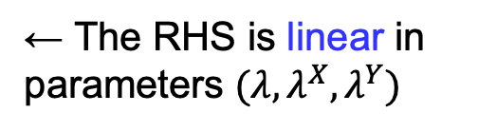
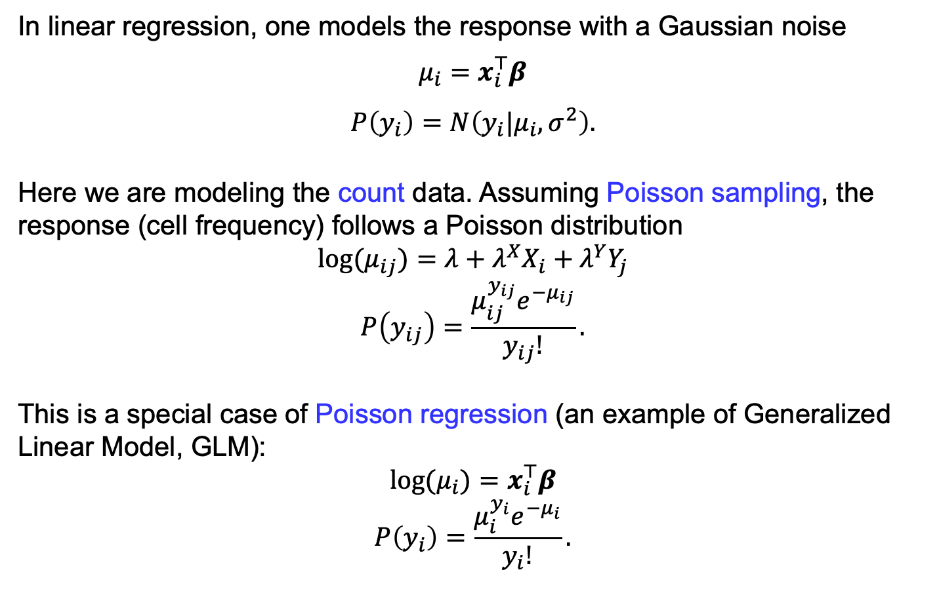
Log-linear model — Regression point of view
In linear regression, one models the response with a Gaussian noise
$$μ_{i}=x_{i}^{⊤}β$$
$$P\left(y_{i}\right)=N\left(y_{i}|μ_{i},σ^{2}\right).$$
Here we are modeling the count data. Assuming Poisson sampling, the response (cell frequency) follows a Poisson distribution
$$\log{(μ_{ij})}=λ+λ^{X}X_{i}+λ^{Y}Y_{j}$$
$$P\left(y_{ij}\right)=\frac{μ_{ij}^{y_{ij}}e^{−μ_{ij}}}{y_{ij}!}.$$
This is a special case of Poisson regression (an example of Generalized Linear Model, GLM):
$$\log{(μ_{i})}=x_{i}^{⊤}β$$
$$P\left(y_{i}\right)=\frac{μ_{i}^{y_{i}}e^{−μ_{i}}}{y_{i}!}.$$
← The RHS is linear in parameters $(λ,λ^{X},λ^{Y})$

Slide 6

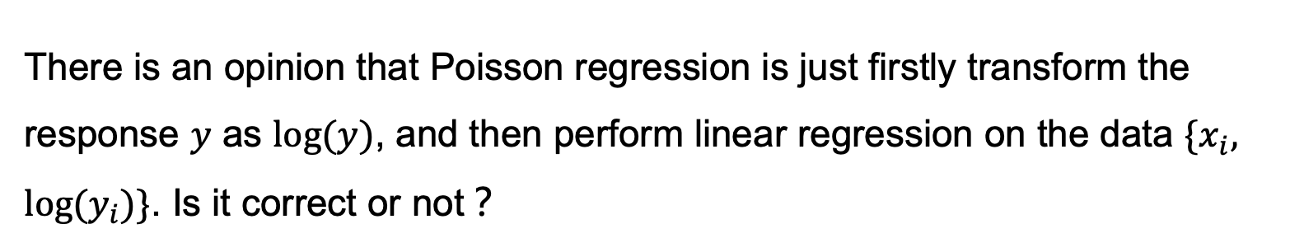
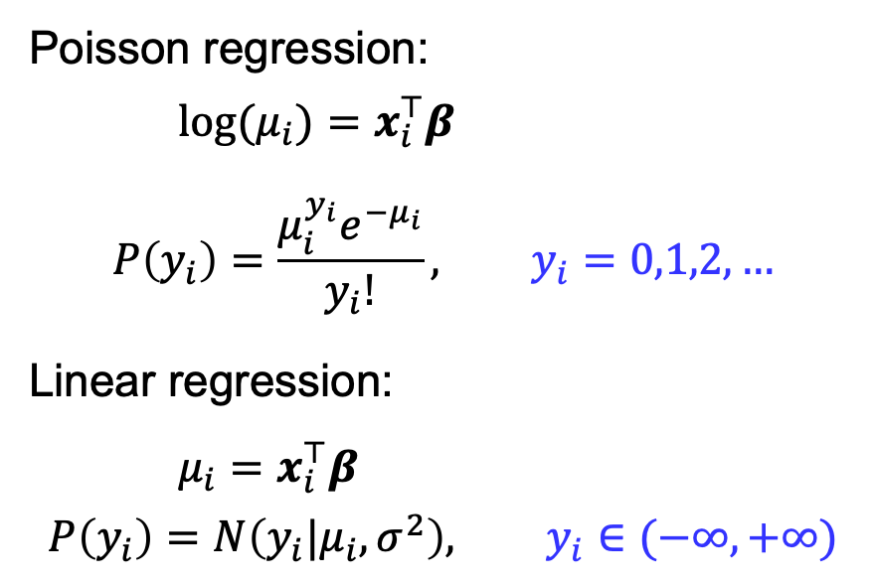
单选题
1分
There is an opinion that Poisson regression is just firstly transform the response $y$ as $\log{(y)}$, and then perform linear regression on the data $\{x_{i}, \log{(y_{i})\}}$. Is it correct or not？
Poisson regression:
$\log{(μ_{i})}=x_{i}^{⊤}β$
$$P\left(y_{i}\right)=\frac{μ_{i}^{y_{i}}e^{−μ_{i}}}{y_{i}!}, y_{i}=0,1,2,…$$
Linear regression:
$μ_{i}=x_{i}^{⊤}β$
$$P\left(y_{i}\right)=N\left(y_{i}|μ_{i},σ^{2}\right), y_{i}∈(−∞,+∞)$$
A
Yes
B
No
提交
Notes:
Answer: B
A problem of the transform-then-lm approach: log(0) is not allowed.

Slide 7
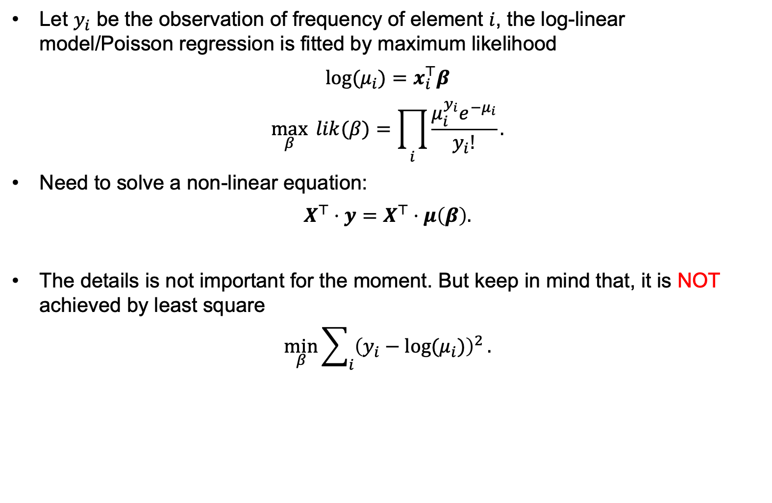
Poisson Regression — Fitting
Let $y_{i}$ be the observation of frequency of element $i$, the log-linear model/Poisson regression is fitted by maximum likelihood
$$\log{(μ_{i})}=x_{i}^{⊤}β$$
$$\max_{β}{ lik(β)}=\prod_{i}{\frac{μ_{i}^{y_{i}}e^{−μ_{i}}}{y_{i}!}}.$$
Need to solve a non-linear equation:
$$X^{⊤}⋅y=X^{⊤}⋅μ\left(β\right).$$
The details is not important for the moment. But keep in mind that, it is NOT achieved by least square
$$\min_{β}{\sum_{i}{{\left(y_{i}−\log{(μ_{i})}\right)}^{2}}}.$$

Slide 8

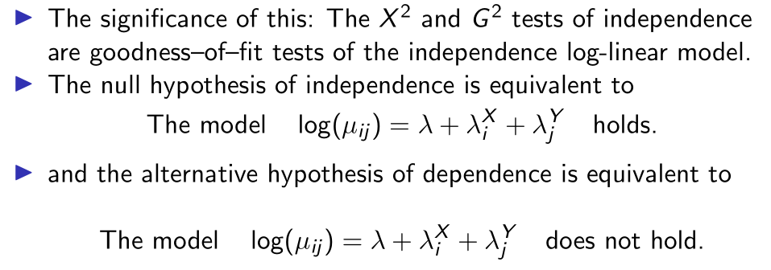
Log-linear model — 2-way Independent Model
MLE estimation of this model is the same as the $H_{0}$ model of chi-squared test of independence:
Equivalence between the Poisson sampling and multinomial sampling.
Notes:
Intuition：mu_ij can be decomposed to outer product of two vectors.
Note: \lambda_i^X is not n_i+

Slide 9
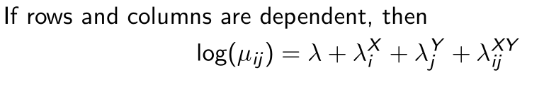
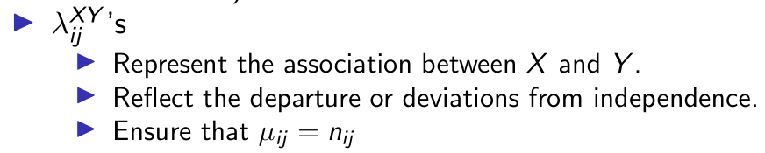
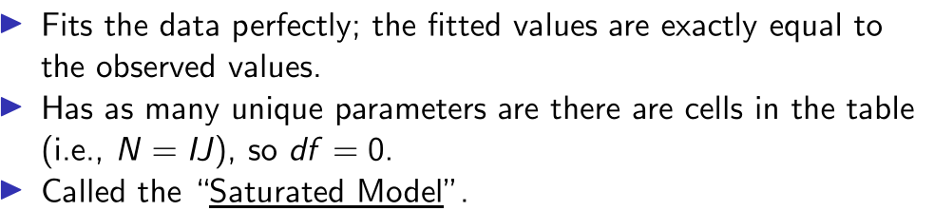
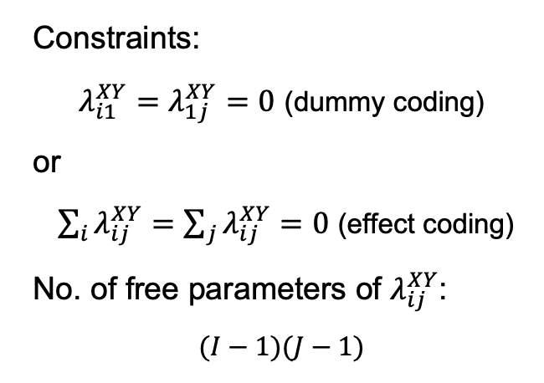
Log-linear model — 2-way Saturated Model
Constraints:
$λ_{i1}^{XY}=λ_{1j}^{XY}=0$ (dummy coding)
or
$\sum_{i}{λ_{ij}^{XY}}=\sum_{j}{λ_{ij}^{XY}=0}$ (effect coding)
No. of free parameters of $λ_{ij}^{XY}$:
$$(I−1)(J−1)$$
Notes:
No. of free parameters in this model:
1 + (I-1) + (J-1) + (I-1)*(J-1) = I*J

Slide 10
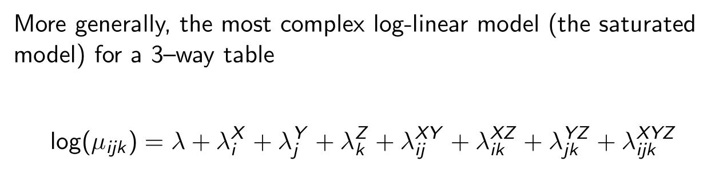
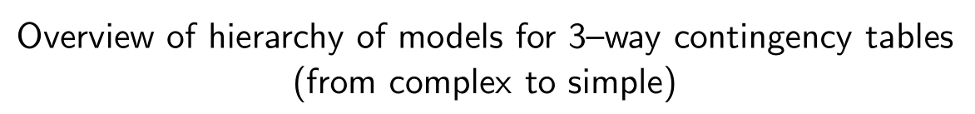
Log-linear model — 3-way table
Straightforward to generalize to n-way table

Slide 11
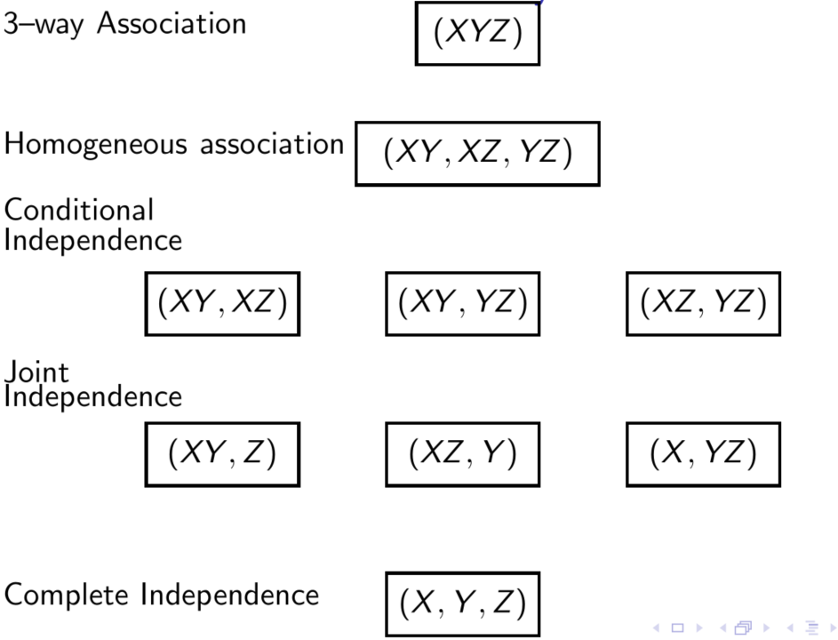




Log-linear model — 3-way table

Slide 12
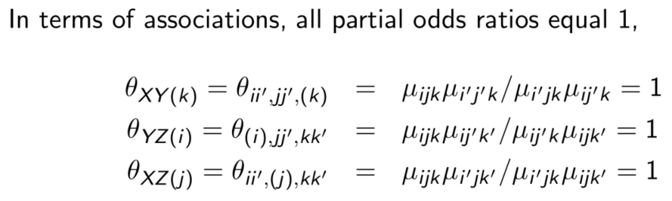
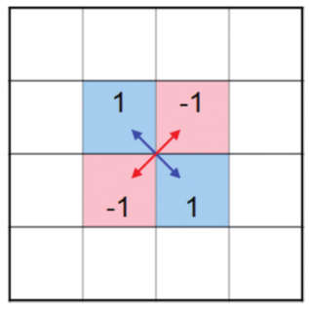



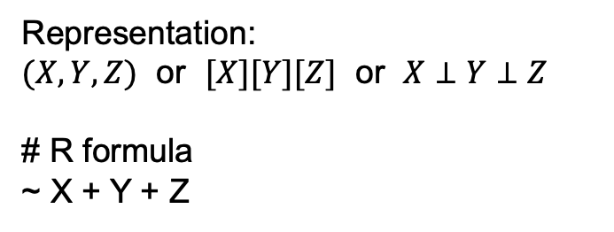

3-way table — Complete Independence
$$j$$
$$j′$$
$$i$$
$$i′$$
Representation:
$(X,Y,Z)$ or $[X][Y][Z]$ or $X⊥Y⊥Z$
# R formula
~ X + Y + Z
Z
X
Y

Slide 13
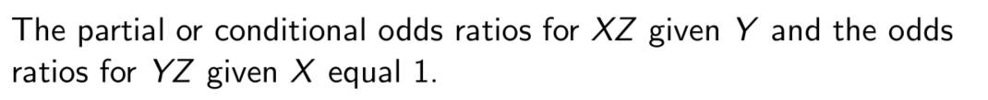
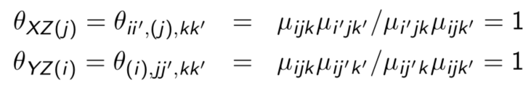
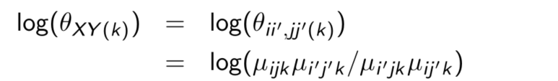
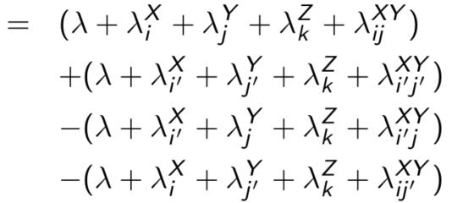
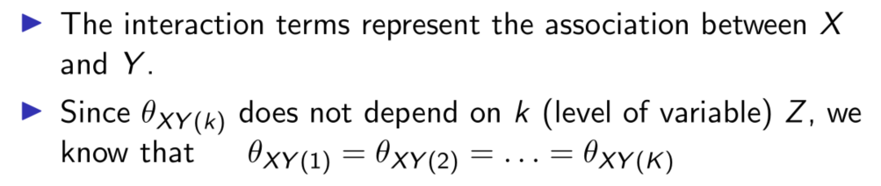

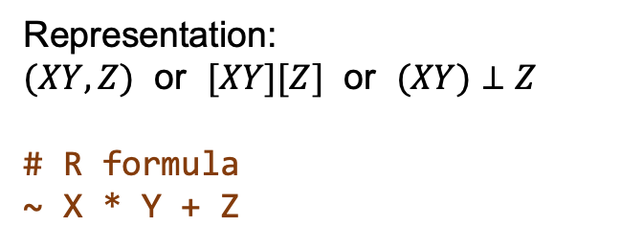
3-way table — Joint Independence
Representation:
$(XY,Z)$ or $[XY][Z]$ or $(XY)⊥Z$
# R formula
~ X * Y + Z
Z
The partial or conditional (log) odds ratios for XY given Z:
X
Y
Notes:
To see why XZ is independent conditioned on j:
$λ_{ij}^{XY}+λ_{i}^{X}→β_{i}^{X}$

Slide 14
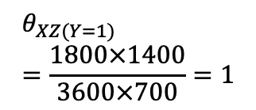
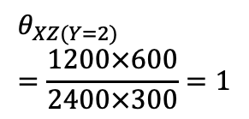
3-way table — Joint Independence — A Scenario
Z Gender = Male |  | Y
 |  | Recover | Not recover | Rec. rate
X | Drug | 1800 | 1200 | 60%
 | No drug | 700 | 300 | 70%
G
Z: Gender
X: Drug
Y: Recovery
D : ND
= 3 : 1
D
R
Observation:
The Drug makes a difference in Recovery.
Gender plays no role in Recovery.
The Drug is assigned to the same proportion in of subjects in both Genders (3/4 this case) (marginal independence between Gender and Drug)
This is only a scenario for illustration; it's not something you can/should control.
In general, unable to control G and R.
In cohort studies, maybe unable to control G and D.
Z Gender = Female |  | Y
 |  | Recover | Not recover | Rec. rate
X | Drug | 3600 | 2400 | 60%
 | No drug | 1400 | 600 | 70%
D : ND
= 3 : 1
$$θ_{XZ(Y=1)}=\frac{1800×1400}{3600×700}=1$$
$$θ_{XZ(Y=2)}=\frac{1200×600}{2400×300}=1$$
Notes:
Maybe the easiest case to analyze for clinical trials ?
(1) Easy to see G ⊥ R | D
(2) For G ⊥ D | R, calculate the odds ratio.

Slide 15
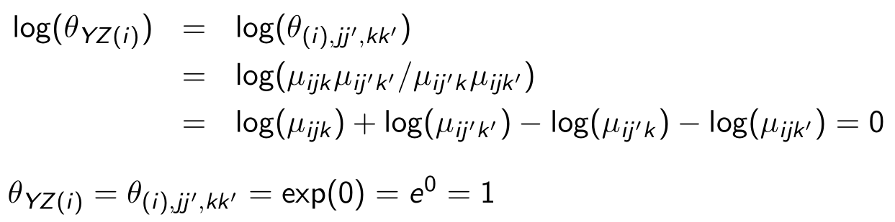
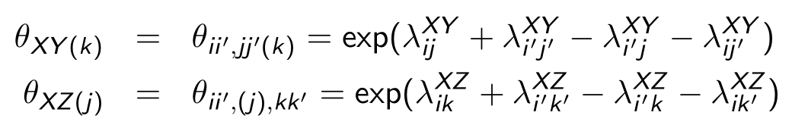
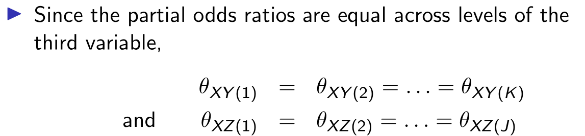
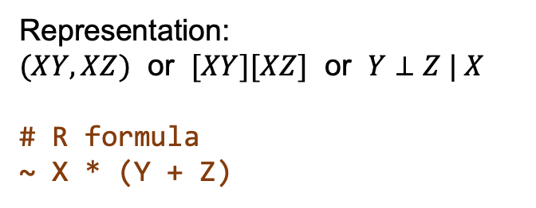
3-way table — Conditional Independence
Representation:
$(XY,XZ)$ or $[XY][XZ]$ or $Y⊥Z | X$
# R formula
~ X * (Y + Z)
Z
The conditional odds ratios for XY and XZ:
X
Y

Slide 16


3-way table — Conditional Independence — A Scenario
Z Gender = Male |  | Y
 |  | Recover | Not recover | Rec. rate
X | Drug | 1800 | 1200 | 60%
 | No drug | 700 | 300 | 70%
G
D : ND
= 3 : 1
D
R
Observation:
The Drug is assigned disproportionately in both Genders (marginal dependence between Gender and Drug)
Gender plays no role in Recovery.
The Drug makes a difference in Recovery.
Marginalize over Drug makes Recovery associated with Gender (M: 62.5%, F: 65%).
This is because more Drugs are given to Male, which has a lower Recovery rate.
Comb. Rec. rate $=\frac{1800+700}{4000}=62.5\%$
Z Gender = Female |  | Y
 |  | Recover | Not recover | Rec. rate
X | Drug | 2400 | 1600 | 60%
 | No drug | 2800 | 1200 | 70%
D : ND
= 2 : 2
Comb. Rec. rate $=\frac{2400+2800}{8000}=65\%$
Notes:
Condition on D:
See both tables with Drug,
Or with No_drug

Slide 17
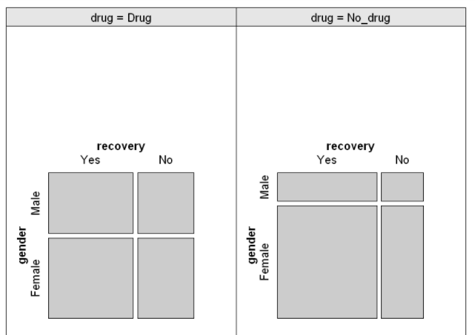
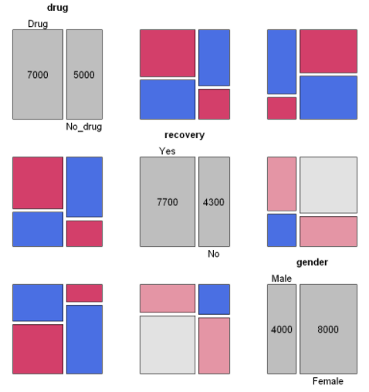
3-way table — Conditional Independence — A Scenario
G
Conditional independence
D
R
Z Gender = Male |  | Y
 |  | Recover | Not recover | Rec. rate
X | Drug | 1800 | 1200 | 60%
 | No drug | 700 | 300 | 70%
D : ND
= 3 : 1
Comb. Rec. rate = 62.5%
Marginal dependence
Z Gender = Female |  | Y
 |  | Recover | Not recover | Rec. rate
X | Drug | 2400 | 1600 | 60%
 | No drug | 2800 | 1200 | 70%
D : ND
= 2 : 2
Comb. Rec. rate = 65%

Slide 18
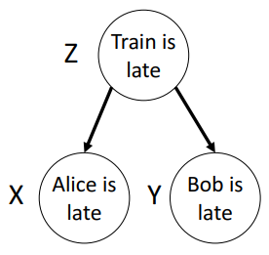
单选题
1分
Alice and Bob often arrive late in the company together. After some investigation, it is found that they usually take the same train in the morning, which has a reputation of being late. Which of the following best describes the association between Alice and Bob ?
A
Joint independent
B
Marginal independent
C
Conditional independent
提交
Notes:
Answer: C

Slide 19
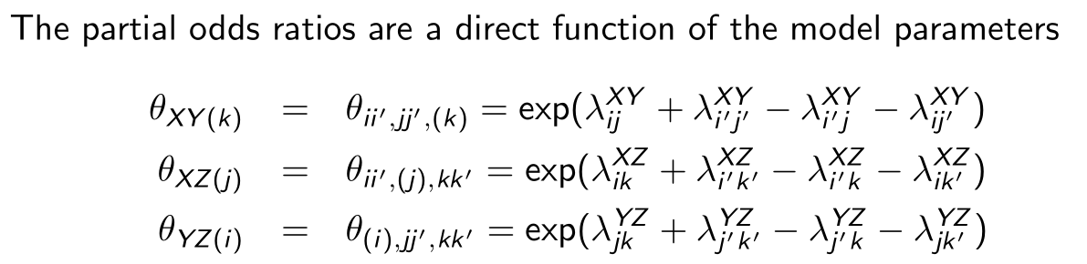
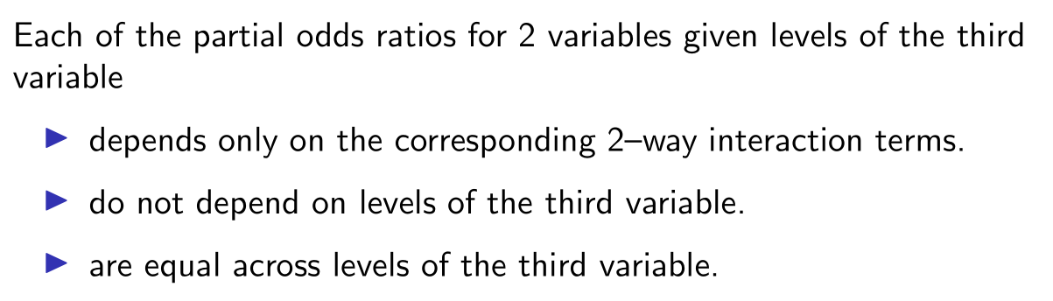
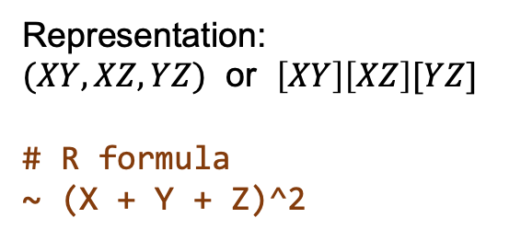
3-way table — Homogeneous Association
Representation:
$(XY,XZ,YZ)$ or $\left[XY\right]\left[XZ\right][YZ]$
# R formula
~ (X + Y + Z)^2
Z
X
Y

Slide 20
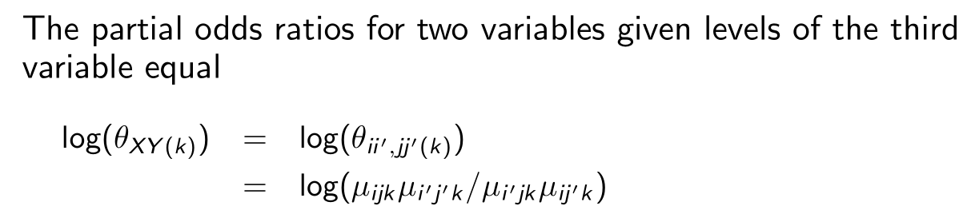
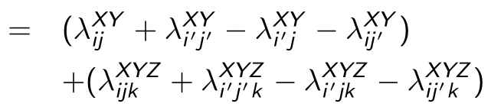
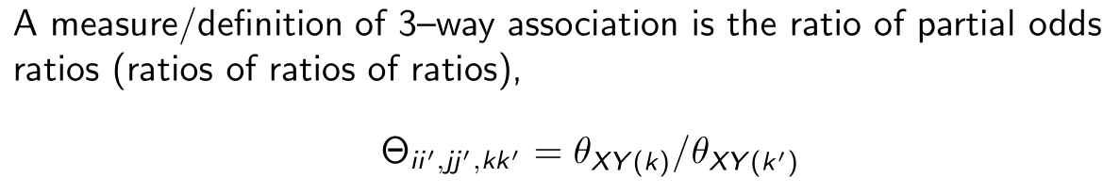
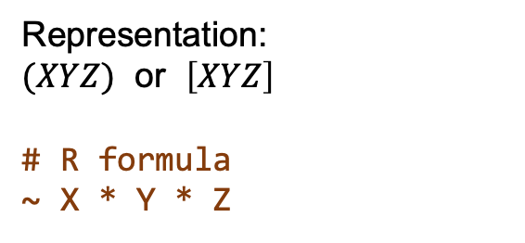
3-way table — 3–way Association (the saturated model)
Representation:
$(XYZ)$ or $\left[XYZ\right]$
# R formula
~ X * Y * Z
Z
X
Y
Cannot be faithfully represented by a network.
Need a factor graph/hyper-graph representation.

Slide 21





3-way table — Summary of Hierarchy of Models
Notes:
df = # cells − # unique parameters
= # cells − (# parameters − # constraints)

Slide 22
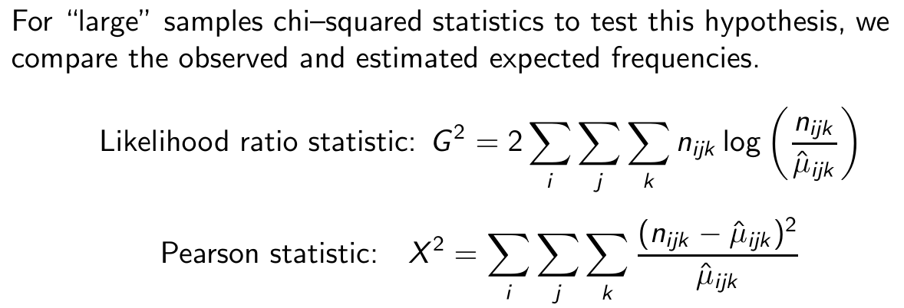
3-way table — (Global) goodness-of-fit tests
$H_{0}$: a particular model gives a good (accurate) description/representation of the data.
Also called the "deviance" in generalized linear model.
Notes:
Same goodness-of-fit tests we’ve seen before.

Slide 23
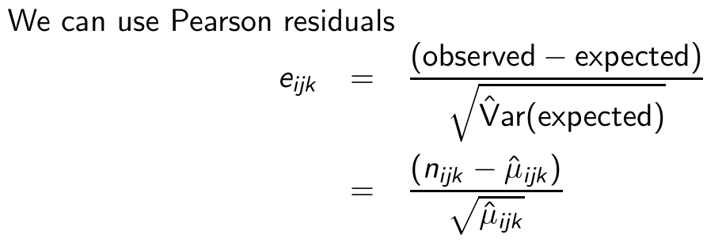
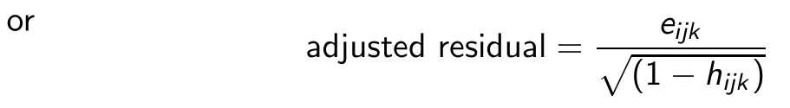


3-way table — (Local) goodness-of-fit tests
Same concepts as standardized residuals as in linear regression.
Notes:
Another perspective why the denominator is E_ijk, but not E^2.
Pearson residuals are correlated and have a non-unit variance.

Slide 24

Comparing nested models
In the likelihood ratio (LR) test for goodness-of-fit of probability distribution and 2-way contingency table, we compare the (to-be-tested) model $M_{0}$ (with likelihood ${lik}_{0}$) to the saturated model $M_{s}$ (with likelihood ${lik}_{s}$).
$$H_{0}: M_{0}$$
$$H_{A}^{′}: M_{s}$$
The LR test statistics (or the deviance of $M_{0}$):
$$LR=G_{0}^{2}=−2\log{\frac{{lik}_{0}}{{lik}_{s}}}$$
where $G_{0}^{2}$ is asymptotically chi-squared distributed with degrees of freedom
$$df_{0}=\dim\left(M_{s}\right)−\dim\left(M_{0}\right)\text{= \# }\text{cells}\text{ − \# }\text{unique} \text{parameters} \text{of} M_{0}\text{.}$$
Notes:
Draw a diagram to illustrate.

Slide 25


Comparing nested models
Now we have a hierarchy of models. So it is possible to compare the model $M_{0}$ to a more complex model $M_{1}$, with deviance
$$G_{1}^{2}=−2\log{\frac{{lik}_{1}}{{lik}_{s}}}$$
and degrees of freedom $df_{1}=\dim\left(M_{s}\right)−dim⁡(M_{1})\text{.}$
If $M_{0}$ is nested within (a special case of) $M_{1}$, we can perform the test
$$H_{0}: M_{0}$$
$$H_{A}^{′}: M_{1}$$
where the LR statistic equals the difference of deviances:
$$LR=G_{0}^{2}−G_{1}^{2},$$
with degrees of freedom $df_{0}−df_{1}$.
Example:
$$M_{0}=\left[X\right]\left[Y\right][Z]$$
$$M_{1}=\left[XY\right]\left[Z\right]$$
$$M_{2}=\left[XY\right]\left[XZ\right]$$
$M_{0}$ is nested within $M_{1}$.
$M_{1}$ is nested within $M_{2}$.
Notes:
Draw a diagram to illustrate.
2-way chi-squared: model against data
Now: model against model

Slide 26



Example — UCB Admissions
loglm() uses effect coding
glm() uses dummy coding
(more supports and extensions)

Slide 27


Example — UCB Admissions
anova() : comparing nested models
LRstats() : compare each model to the saturated

Slide 28

投票
最多可选1项
Which model do you prefer ?
A
Model 5
B
Model 7
提交

Slide 29



Example — UCB Admissions
Model 5:
$Admit⊥Gender | Dept$
(Conditional independence)
Model 7:
$(AD,GD, AG)$
(Homogeneous association)
A
A
D
G
D
G
In the last lecture, we learnt that the hypothesis testing of conditional independence (CMH test) is not very reliable.
Using a log-linear model approach, the conditional independent model (DA, DG) explains the data pretty well, though not perfect.
Adding the additional association (AG) doesn't improved much.
The remaining residuals (due to Dept A), needs to be explained by a 3-way association term.

Slide 30


Example — UCB Admissions
Model 5:
Model 7:
anova() for hypothesis testing of models
A
A
D
G
D
G
Which model to choose
Subjective Judgment
Model 7 wins by goodness-of-fit
Model 5 wins by simplicity
Results:
$H_{0}: A⊥G | D, H_{1}: (AD,GD, AG)$, p-value=0.21
$H_{0}:(AD,GD, AG)\text{,} H_{1}: (ADG)$, p-value=0.0011
No good reason to prefer Model 7 over Model 5.

Slide 31

Example — UCB Admissions
local fit visualized by mosaic():
Dept A is the main problem of lack-of-fit.
Technical:
To extract the Pearson residuals for more detailed analysis, use:
residuals(UCB.loglm5, type="pearson")
To obtain adjusted/standardized residuals, loglm() models is not convenient. Use model glm() and the rstandard() function (see later)

Slide 32



Example — UCB Admissions
Observables to concern:
(log) odds of being admitted
$$\log\left(\frac{μ_{i1k}}{μ_{i2k}}\right)=\left(λ+λ_{i}^{X}+λ_{1}^{Y}+λ_{k}^{Z}+λ_{i1}^{XY}+λ_{ik}^{XZ}\right)−\left(λ+λ_{i}^{X}+λ_{2}^{Y}+λ_{k}^{Z}+λ_{i2}^{XY}+λ_{ik}^{XZ}\right)$$
$=λ_{1}^{Y}$- $λ_{2}^{Y}$+ $λ_{i1}^{XY}$- $λ_{i2}^{XY}$
Except for Dept A, the "prediction" is OK.

Slide 33
Case Study

Slide 34


Example — Educational Aspirations in Wisconsin
Socio-economic Status, Parental Encouragement and Educational Aspirations of High School Seniors in Wisconsin.
Fienberg (1977, p. 101)

Slide 35


Example — Educational Aspirations in Wisconsin — Exploration
Marginal plots:
Notes:
Observation:
SES on Encouragement: (1, 3) -> higher class, more encouragement
SES on Plan: (2, 3) -> higher class, more plans
Encouragement on Plan: (1, 2) -> more encouragement, more plans
Seems are three attributes are marginally associated.

Slide 36


Example — Educational Aspirations in Wisconsin — Exploration
Conditional plots:
Notes:
In all SES, higher encourangement -> more plans.
The double-decker plot is very informative here (in fact, the SES is an ordered factor).
Observation:
(1) high encouragement always better for different SES.
(2) high SES -> high Plan, for either encouragement.
Reflects the huge difference for different SES…

Slide 37

Example — Educational Aspirations in Wisconsin — Analysis
glm() for log-linear model:

Slide 38


Example — Educational Aspirations in Wisconsin — Analysis
anova() -> comparing nested models
LRstats() -> compare each model to the saturated
Notes:
Model 4,5,6 not a good fit.
Model 7 fits very well.

Slide 39





Example — Educational Aspirations in Wisconsin — Analysis
Local fit:
To extract residuals:

Slide 40


Example — Educational Aspirations in Wisconsin — Analysis
LR/chisq test for Model 7:
$H_{0}: \left[ES\right]\left[PE\right]\left[PS\right]$
$H_{1}^{′}: saturated (3 way association)$
p-value = 0.665
The model homogeneous association already explains the data very well.
Conclusion:
No evidence for 3-way association
The association between any two is the same at all levels of the third.
Association between parental encouragement E and college plans P is the same in all social strata.
(in fact already given in the results of LRstats() in the last page.)

Slide 41

Example — Educational Aspirations in Wisconsin — Analysis
Association between parental encouragement E and college plans P is the same in all social strata.

Slide 42

Example — Educational Aspirations in Wisconsin — Analysis
Woolf or Breslow-Day test do not reject homogeneity of odds ratios.
No evidence for 3-way association.

Slide 43

Example — Educational Aspirations in Wisconsin — Analysis
Conditional independence is not supported.
As the assumption for the test is met, we can extract the common odds ratio for use.

